Slide 1
Wood and Engineered Wood Products
Part 2

Slide 2
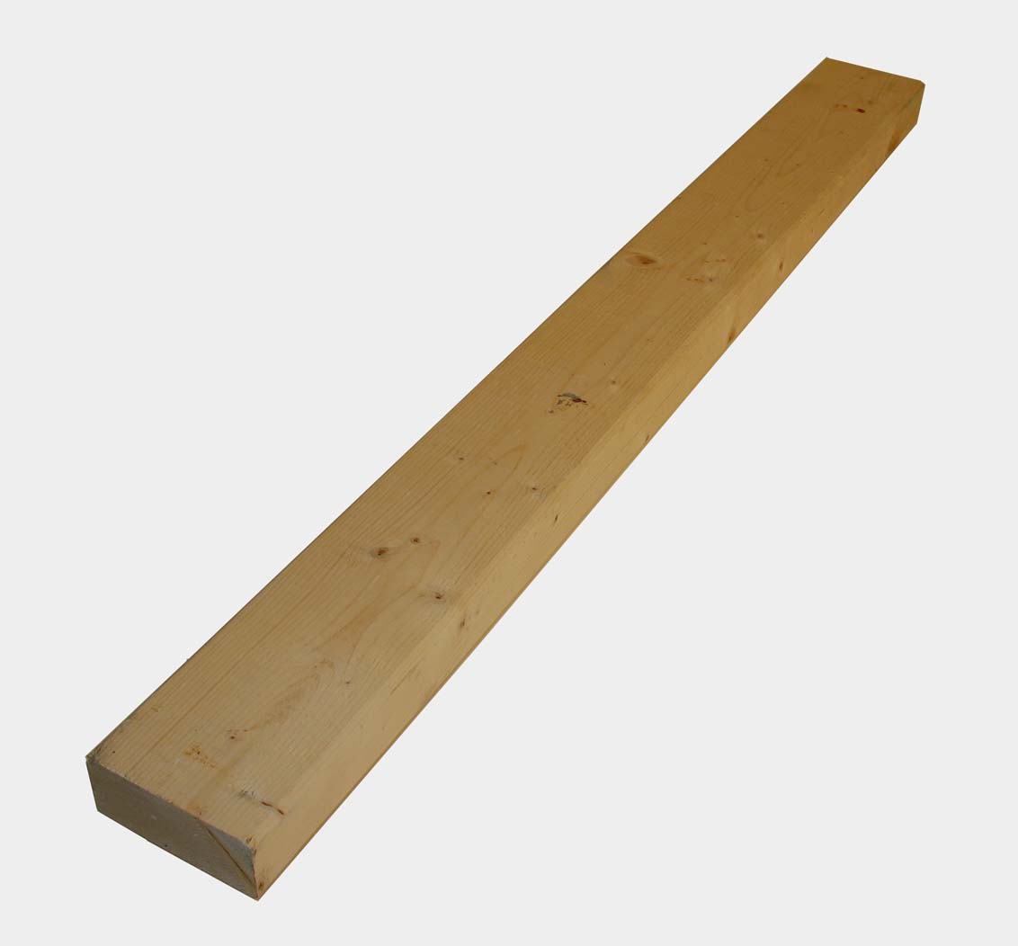
Types of Lumber – rough sawed or dressed. Green or Dry

Slide 3
Lumber is graded based on the number of defects it has.

Slide 4
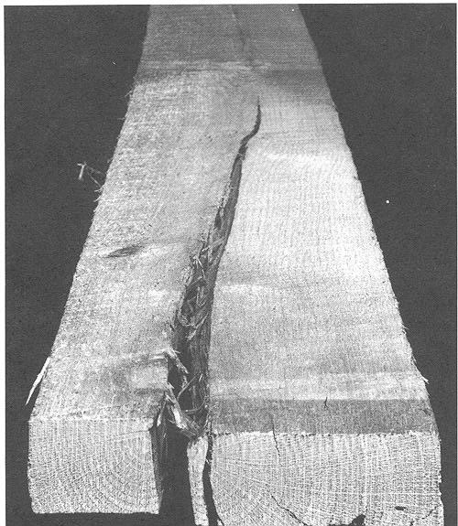
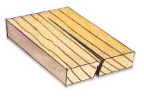
Defects in Wood: knots, check, split,

Slide 5
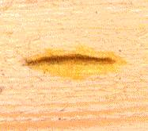
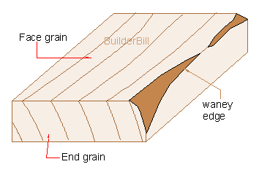
Defects in Wood – decay, stain, wane,

Slide 6
Defects in Wood - warp

Slide 7
Grading

Slide 8
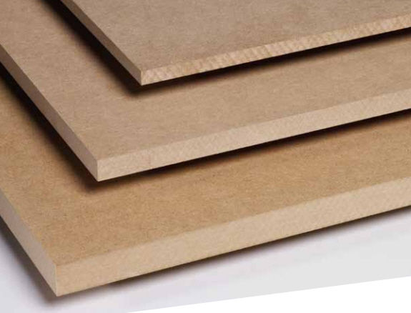
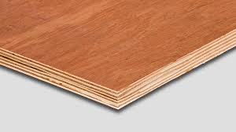
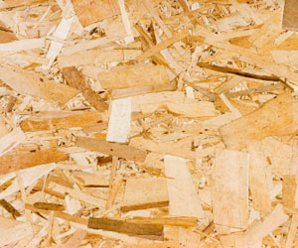
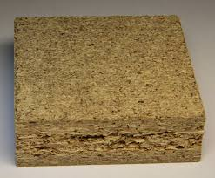
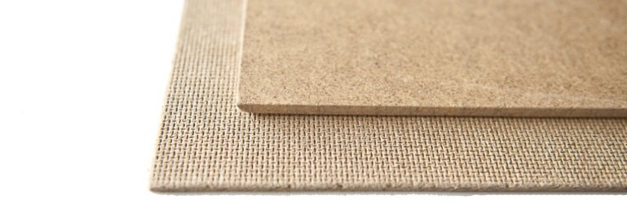
Plywood and Wood Panels

